Slide 1
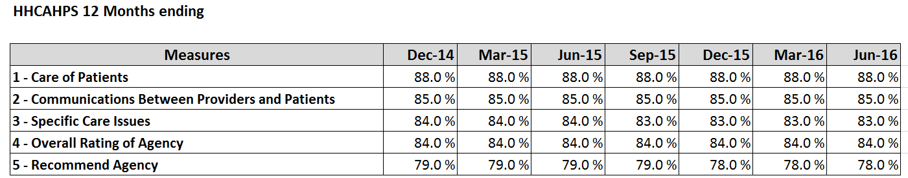
CMS HHCAHPS National Data Trend

Slide 2
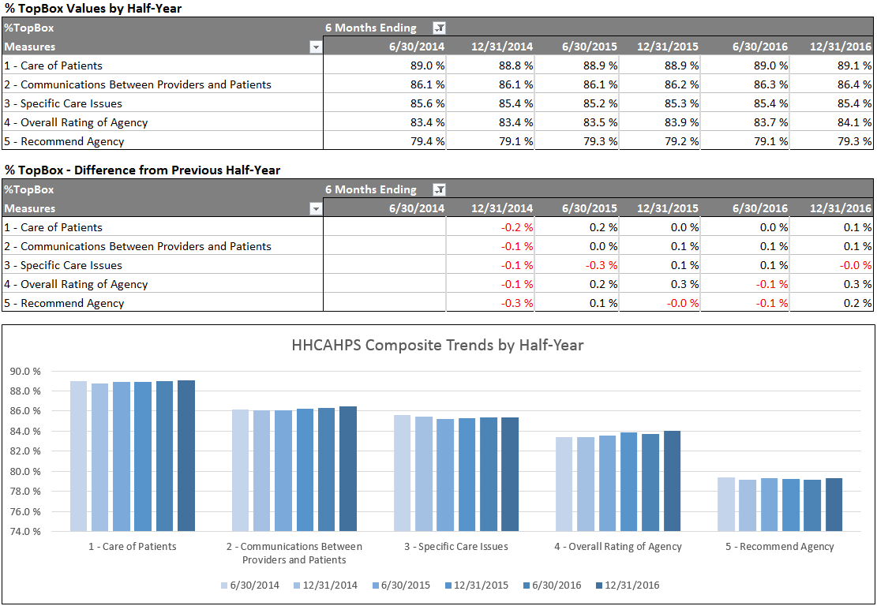
SHP HHCAHPS - National Data Trend
Note: Only CCNs with data for entire time period

Slide 3
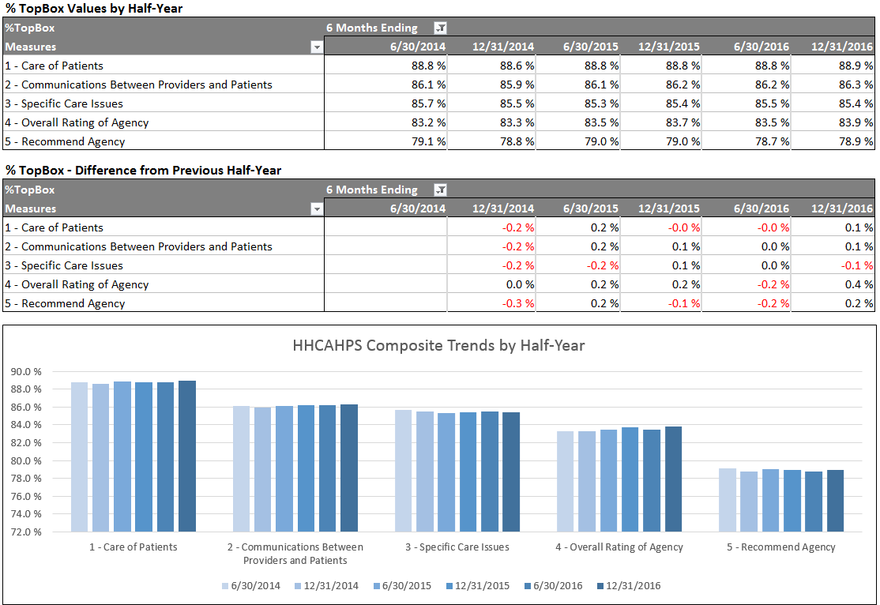
SHP HHCAHPS - Non-VBP States Trend
Note: Only CCNs with data for entire time period

Slide 4
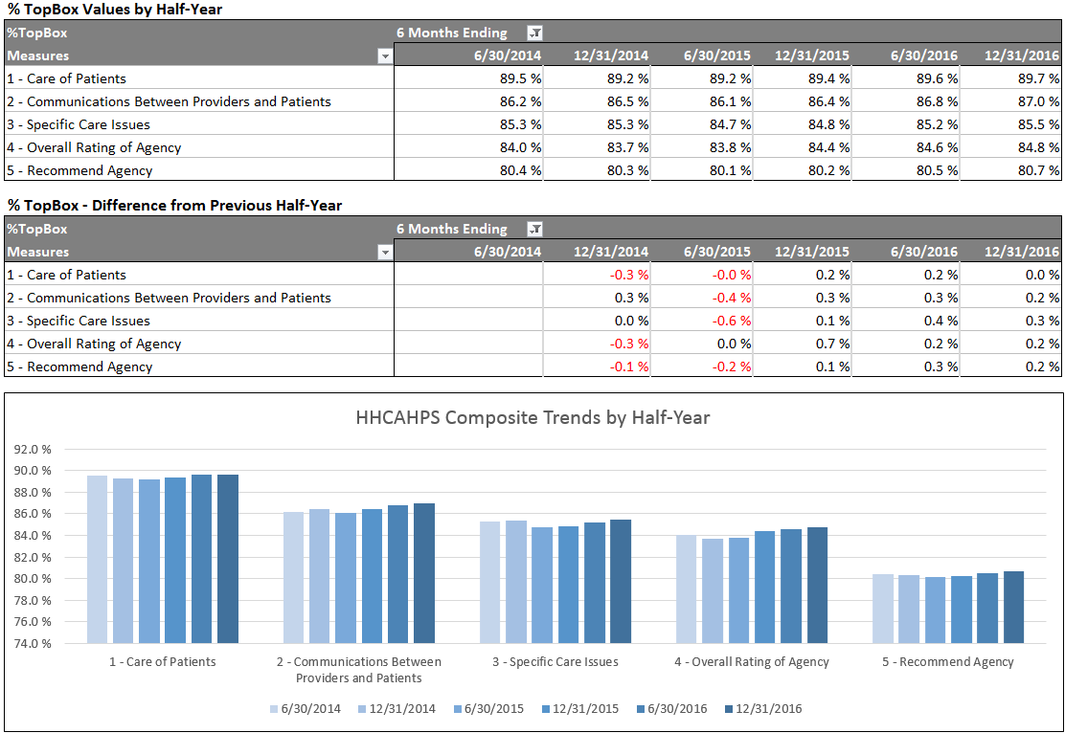
SHP HHCAHPS - VBP States Trend
Note: Only CCNs with data for entire time period

