Slide 1
Monthly HHFMA
Call With The Experts
December 19, 2018
Cost Per Visit
Presenter:
Thomas Boyd, MBA, CFE, CHFP
VP of Reimbursable Services

Slide 2
NAHC Data Compendium
Cost Report Data Reports
The NAHC COST REPORT DATA COMPENDIUM is an in-depth analysis of Medicare cost reports filed by home health agencies since the beginning of the HH PPS payment system in October 2000. NAHC has acquired nearly 150,000 filed cost reports to develop this Compendium.
The Compendium is a valuable tool for providers of services, consultants, health policy planners, home care advocates, investors, and trade associations looking to gain an understanding of the financial status of home health agencies. However, it must be understood this tool is not intended to be used to affect the planning and delivery of care to individual patients. It must be further understood that while the methodology used by NAHC to conduct this analysis has been validated the cost report data used is unaudited.
http://hhfma.org/memberresources/

Slide 3

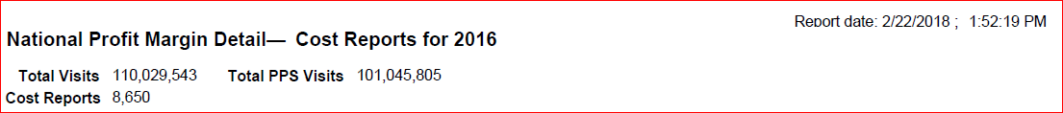
Total Cost Per Visit
National | SN | PT | OT | ST | MSW | HHA
2017 | $182.84 | $174.91 | $174.10 | $190.88 | $259.70 | $81.52
National | SN | PT | OT | ST | MSW | HHA
2016 | $154.84 | $181.59 | $179.88 | $192.99 | $236.66 | $70.10

Slide 4
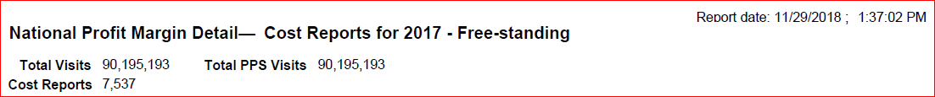

Total Cost Per Visit
Free - Standing | SN | PT | OT | ST | MSW | HHA
2017 | $155.09 | $168.57 | $166.08 | $183.32 | $230.38 | $71.84
Free - Standing | SN | PT | OT | ST | MSW | HHA
2016 | $146.12 | $180.31 | $178.02 | $191.08 | $226.43 | $66.73

Slide 5


Total Cost Per Visit
Hospital Based | SN | PT | OT | ST | MSW | HHA
2017 | $250.67 | $190.74 | $195.72 | $212.48 | $356.63 | $106.43
Hospital Based | SN | PT | OT | ST | MSW | HHA
2016 | $239.62 | $194.59 | $200.30 | $213.23 | $363.63 | $103.34

Slide 6

Total Cost Per Visit
Rural | SN | PT | OT | ST | MSW | HHA
2017 | $200.66 | $168.75 | $166.91 | $175.11 | $269.77 | $88.93
Rural | SN | PT | OT | ST | MSW | HHA
2016 | $169.66 | $159.23 | $162.75 | $181.07 | $253.43 | $71.91

Slide 7

Total Cost Per Visit
Urban | SN | PT | OT | ST | MSW | HHA
2017 | $172.33 | $178.49 | $177.91 | $198.35 | $256.85 | $77.32
Urban | SN | PT | OT | ST | MSW | HHA
2016 | $151.87 | $185.98 | $183.00 | $195.21 | $234.55 | $69.72

Slide 8


2016 vs. 2017 Profit (Loss)
National | Greater than 50 % | 25 % - 50 % | 10 % - 25 % | 0 % - 10 % | Loss
2017 | 3.3 % | 34.40 % | 19.0 % | 15.2 % | 28.20 %
National | Greater than 50 % | 25 % - 50 % | 10 % - 25 % | 0 % - 10 % | Loss
2016 | 3.4 % | 34.20 % | 19.3 % | 16.0 % | 27.10 %

Slide 9
HHFMA Benchmark of the Month
Hospital Discharge Trends to Post Acute
December 19, 2018
Matthew Garcia
Solutions Engineer and Channel Partner Manager.

Slide 10
Data Source: 2017 Annual Industry Trend Report
The Excel Health Annual Industry Trend Report highlights the most recent trends and provides a full year (2017) synopsis of the home health and hospice markets.
Medicare and Hospice data is reported through Q4 2017.
For home health, we report through Q3 2017.
While we present Q4 2017 in the Excel Health Market Intelligence Portal.

Slide 11
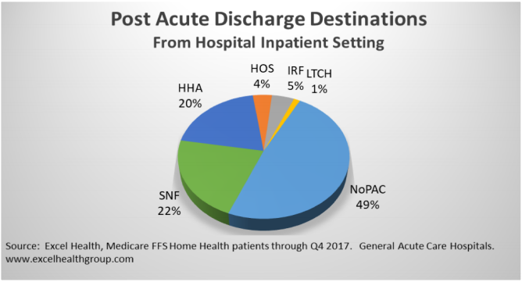
Benchmark – Discharge Trends
Benchmark through Q4-2017:
Almost half (48.5%) of patients who were discharged from a hospital stay did not receive post-acute care instructions in 2017
As of the latest Industry Trend Report (Q2-2018), approximately half of Medicare patients discharged from a hospital do not receive any post-acute instruction or referral.
Consistent data that may highlight habitual behavior of the hospital discharge planners
Hospital Discharges to SNF = 22%
Hospital Discharges to HH = 20%

Slide 12
Benchmark Application
Significant Diversity among states
Those patients discharged in the northeastern states of CT, MA, RI, NH, and VT are more likely to be discharged with post-acute follow up instructions
Patients in the western states of OR, HI, WY, MT, and AK were less likely to receive post-acute discharge instructions.
Discharges to hospice, inpatient-rehab, and LTC hospitals only account for 10% of all hospital discharges

Slide 13
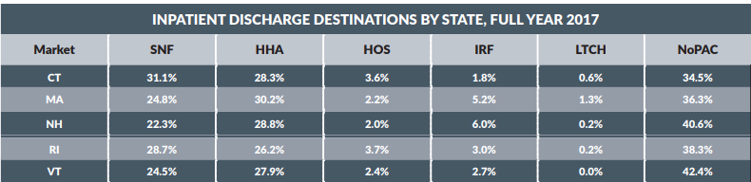
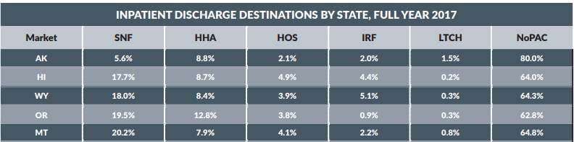
Hospital Discharge Trends
Top 5 Discharge Destinations
Bottom 5 Discharge Destinations

Slide 14
What this means and Improvement
With almost half of hospital discharges receiving no post-acute care agencies see less patient revenue
With less patients discharged into home care a gap would exist in the healthcare continuum
Readmissions are higher for those patients who do not obtain home health care
Data to share with hospital discharge planners to make a case for home health care

