Slide 1

HHVBP Insights
HHFMA Call with the Experts
January 16, 2019
Chris Attaya
VP of Product Strategy
Notes:
Zeb

Slide 2
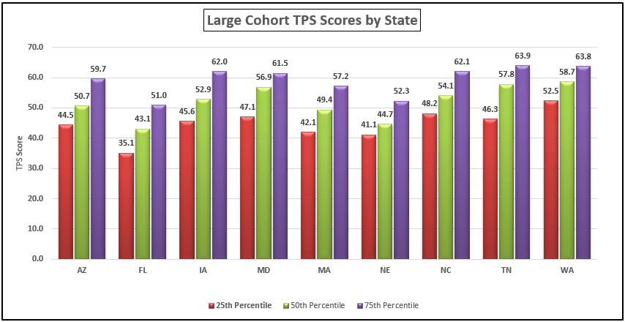
HHVBP Performance Year 2 – CY 2017
Source: CMS Final TPS Adjustment Report PY2

Slide 3
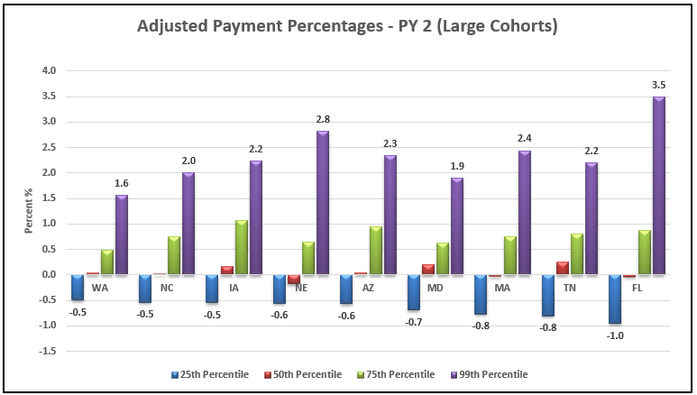
HHVBP Performance Year 2 – CY 2017
Source: CMS Final TPS Adjustment Report PY2

Slide 4
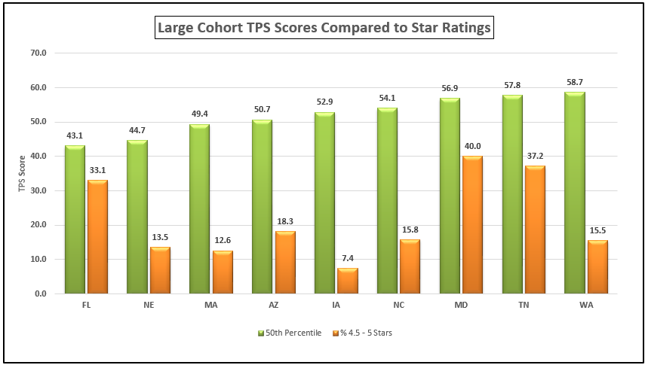
HHVBP Performance Year 2 – CY 2017
Source: Home Health Compare – Oct 2018 refresh

